Slide 1




PERSONAL DATA MANAGEMENT SYSTEM
-BY
SADHANA A(220701235)
RUPALA N(220701233)

Slide 2



ABSTRACT
In the digital age, managing personal data securely is essential. This project introduces a Personal Data Management System (PDMS) that empowers individuals to organize their data effectively.
The PDMS offers secure data storage, user-friendly interfaces, customizable privacy settings, and tools for consent-based data sharing.
It complies with regulations like GDPR and CCPA. The system features data analytics for insights and supports integration with external services.
By providing intuitive controls and transparency, the PDMS enhances user empowerment and data security, offering a reliable solution for personal data management in a connected world.

Slide 3



OBJECTIVES
-The primary goal of this project is to design and implement a robust Personal Information Management System (PIMS) that empowers users to securely manage their personal data.
- The system should provide features like user registration, authentication, data storage, consent management, privacy settings, and compliance with data protection regulations.

Slide 4



KEYWORDS
- Personal Data Management
- Data Privacy
- Data Security
- GDPR
- CCPA
- Encryption
- Data Analytics
- User Empowerment
- Interoperability
- Data Integration

Slide 5


PROPOSED SOLUTION
- a PIMS that allows users to manually enter and manage their personal data securely
- User-Friendly Interfaces
- Customizable Privacy Settings
- Consent-Based Data Sharing
- Regulatory Compliance (GDPR, CCPA)
- Data Analytics for Insights
- Interoperability with External Services
- *User Empowerment through Intuitive Controls
- Transparency and Accountability
-Secure Storage
This ensures secure, efficient, and user-centric personal data management.

Slide 6


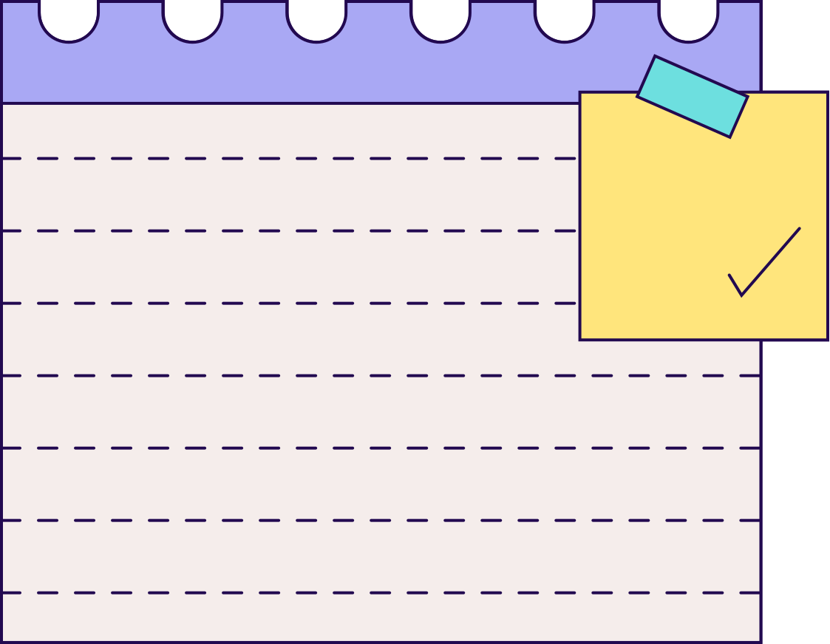

FUTURE
SCOPE
01
Advanced Security Features: Multi-factor authentication and biometrics
02
AI and Machine Learning: Predictive analytics and recommendations
03
Blockchain Integration: Immutable audit trails
Cross-Platform Support: Broader device compatibility

Slide 7





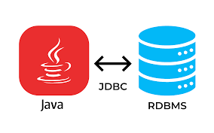
TECHNOLOGY STACK
FRONT END
BACKEND
DATABASE
-- java swing
Language - SQL
Platform - MySQL
--Java for logic
jdbc for connectivity

Slide 8
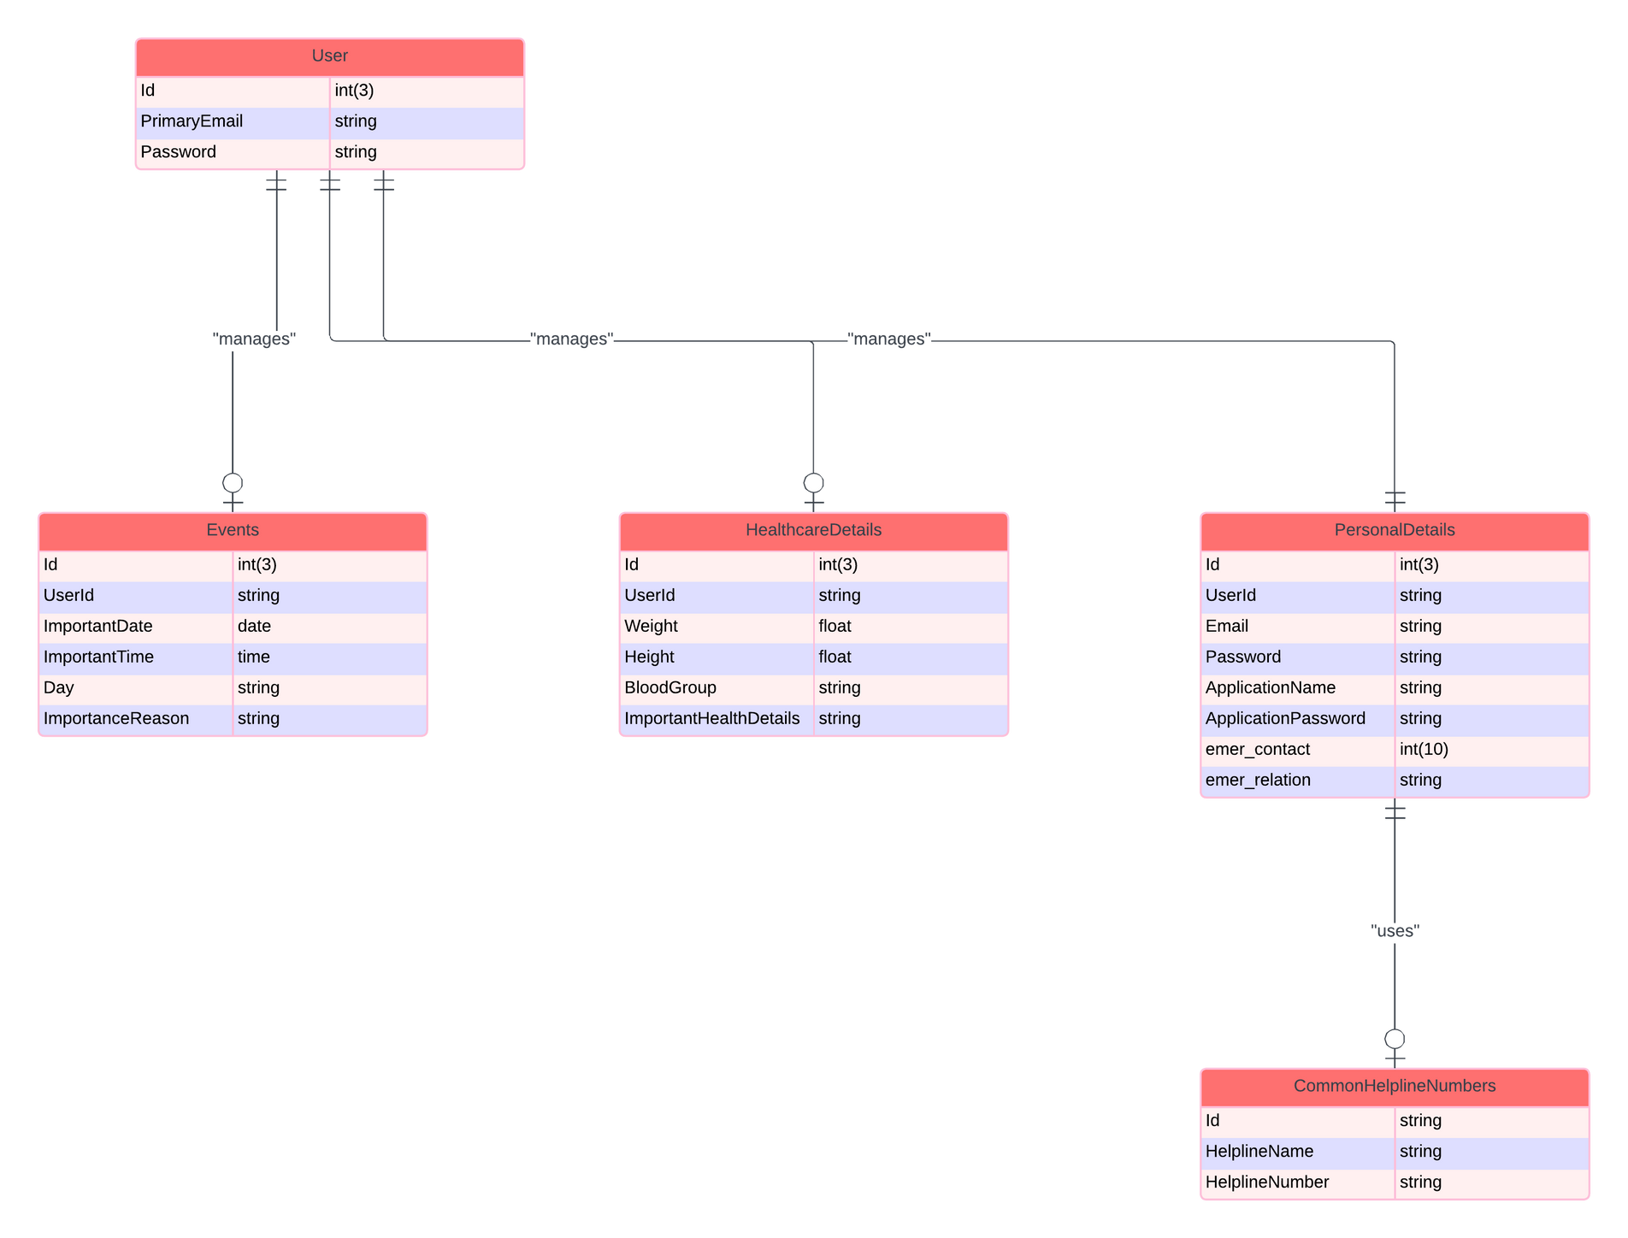


ER DIAGRAM

Slide 9
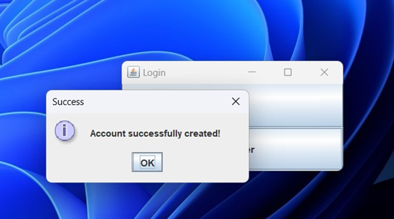
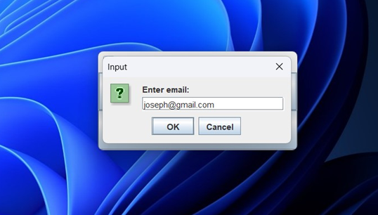
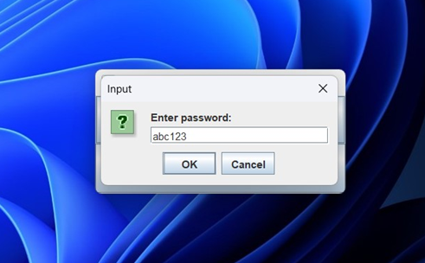
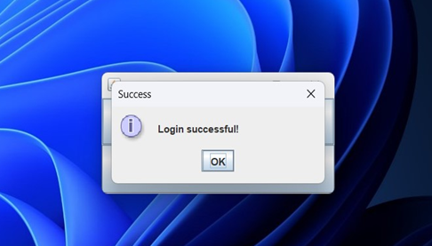
Account Creation & User Login

Slide 10
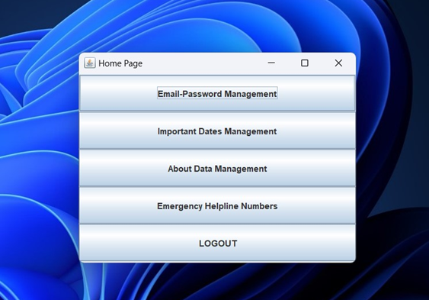
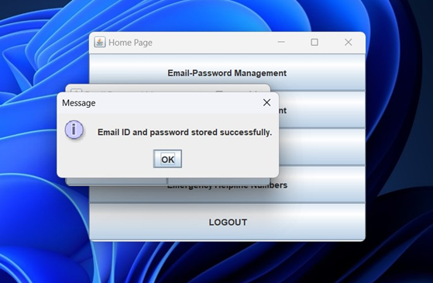
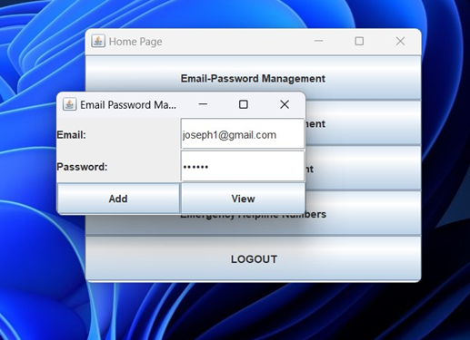
Home page & Email-passwords

Slide 11
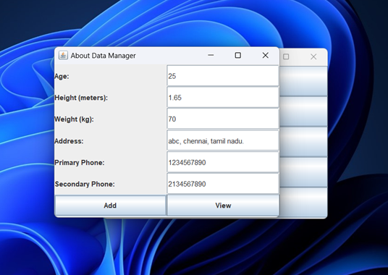
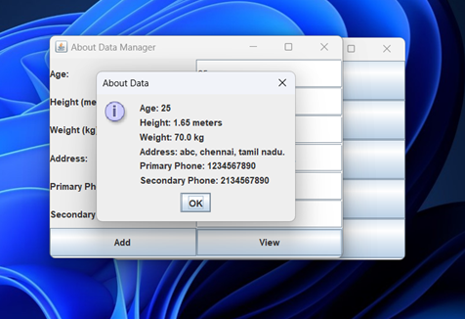
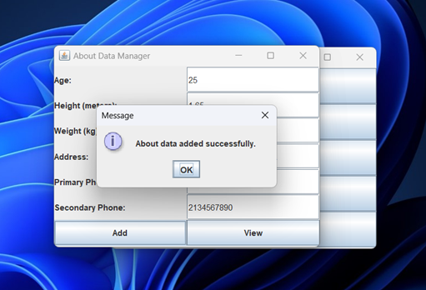
ADD & VIEW ABOUT

Slide 12
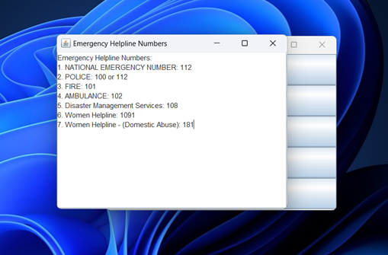
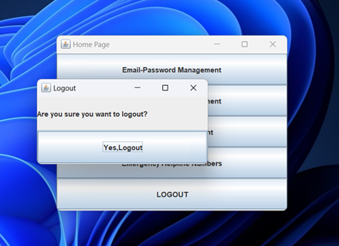
HELPLINE & LOGOUT

Slide 13

Thank you!
www.reallygreatsite.com

